Slide 1



Introduction to MATLAB Programming
Lecture 2
Dr. Mrittunjoy Guha Majumdar
UPES Dehradun

Slide 2
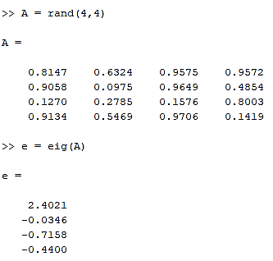
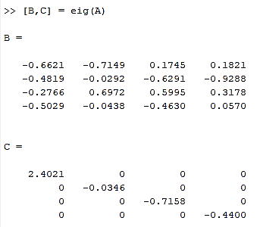
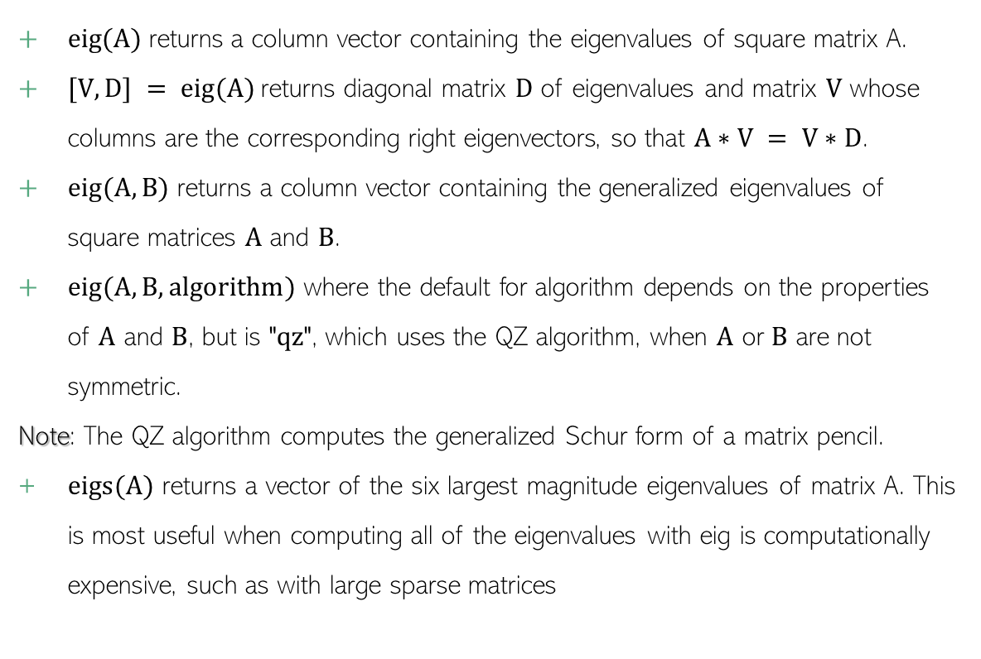
eig Eigen-Analysis
eig(A) returns a column vector containing the eigenvalues of square matrix A.
$[V,D] = eig(A)$ returns diagonal matrix $D$ of eigenvalues and matrix $V$ whose columns are the corresponding right eigenvectors, so that $A∗V = V∗D$.
$eig(A,B)$ returns a column vector containing the generalized eigenvalues of square matrices $A$ and $B$.
$eig(A,B,algorithm)$ where the default for algorithm depends on the properties of $A$ and $B$, but is "$qz$", which uses the QZ algorithm, when $A$ or $B$ are not symmetric.
Note: The QZ algorithm computes the generalized Schur form of a matrix pencil.
$eigs(A)$ returns a vector of the six largest magnitude eigenvalues of matrix A. This is most useful when computing all of the eigenvalues with eig is computationally expensive, such as with large sparse matrices
MGM
Dr. Mrittunjoy
Guha Majumdar

Slide 3
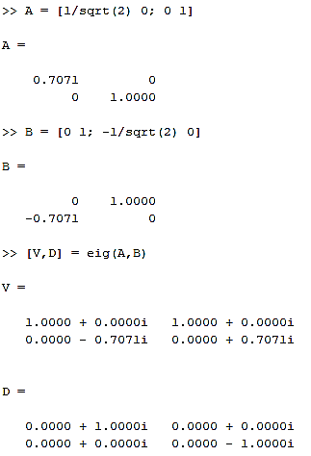
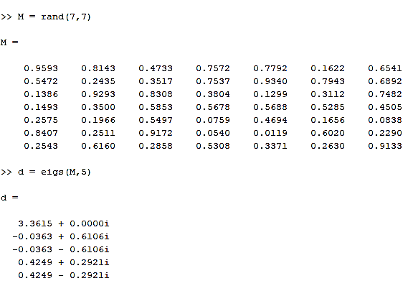

$eigs\left(A,k\right)$ returns the $k$ largest magnitude eigenvalues of $A$.
Reference: Stewart, G.W. "A Krylov-Schur Algorithm for Large Eigenproblems." SIAM Journal of Matrix Analysis and Applications. Vol. 23, Issue 3, 2001, pp. 601–614.
MGM
Dr. Mrittunjoy
Guha Majumdar

Slide 4
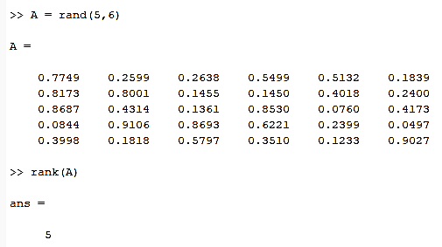
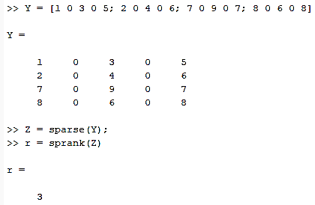
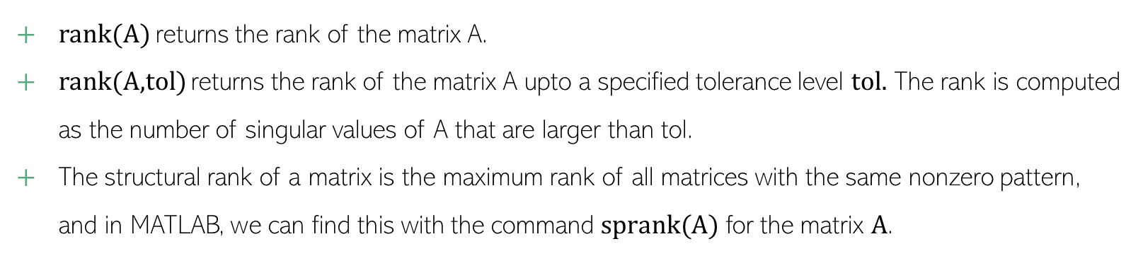
Rank of a Matrix
rank(A) returns the rank of the matrix A.
rank(A,tol) returns the rank of the matrix A upto a specified tolerance level $tol.$ The rank is computed as the number of singular values of A that are larger than tol.
The structural rank of a matrix is the maximum rank of all matrices with the same nonzero pattern, and in MATLAB, we can find this with the command $sprank(A)$ for the matrix $A$.
MGM
Dr. Mrittunjoy
Guha Majumdar

Slide 5

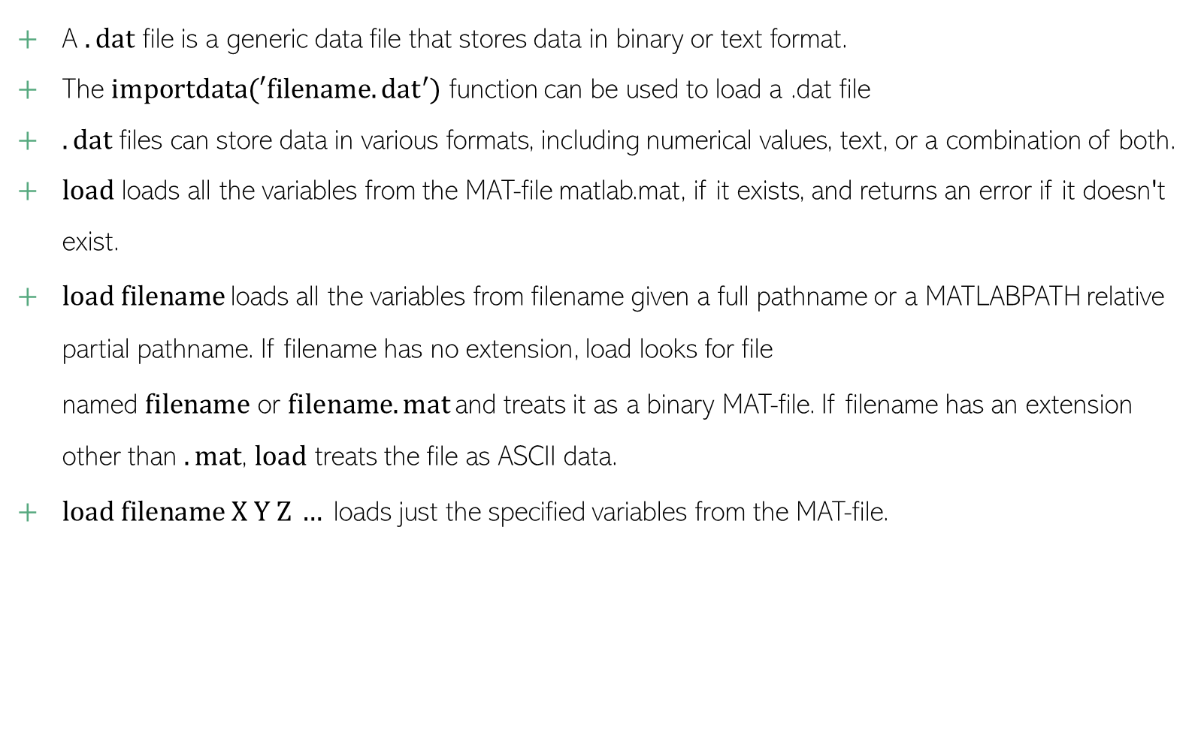
Reading a $.dat$ File
A $.dat$ file is a generic data file that stores data in binary or text format.
The $importdata(′filename.{dat}^{′})$ function can be used to load a .dat file
$.dat$ files can store data in various formats, including numerical values, text, or a combination of both.
$load$ loads all the variables from the MAT-file matlab.mat, if it exists, and returns an error if it doesn't exist.
$load filename$loads all the variables from filename given a full pathname or a MATLABPATH relative partial pathname. If filename has no extension, load looks for file named $filename$ or $filename.mat$and treats it as a binary MAT-file. If filename has an extension other than $.mat$, $load$ treats the file as ASCII data.
$load filename X Y Z …$loads just the specified variables from the MAT-file.
MGM
Dr. Mrittunjoy
Guha Majumdar

Slide 6
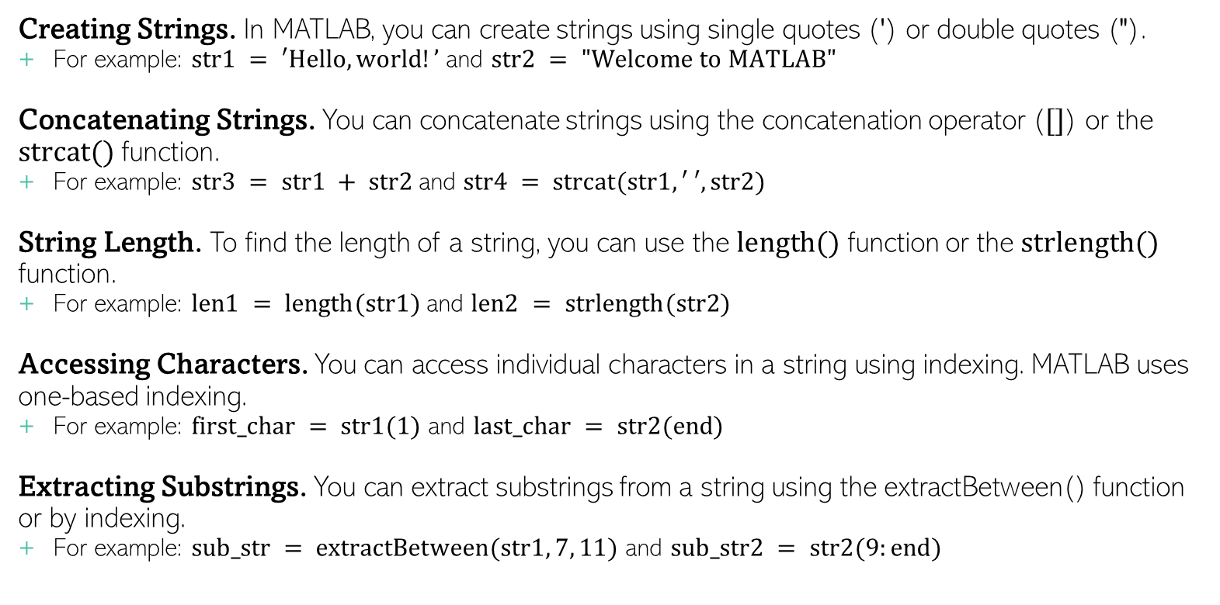
Working with Strings
Creating Strings. In MATLAB, you can create strings using single quotes (') or double quotes (").
For example: $str1 = ′Hello, world!’$ and $str2 = "Welcome to MATLAB"$
Concatenating Strings. You can concatenate strings using the concatenation operator ($[]$) or the $strcat()$ function.
For example: $str3 = str1 + str2$and $str4 = strcat(str1, ′ ′, str2)$
String Length. To find the length of a string, you can use the $length()$ function or the $strlength()$ function.
For example: $len1 = length(str1)$and $len2 = strlength(str2)$
Accessing Characters. You can access individual characters in a string using indexing. MATLAB uses one-based indexing.
For example: $first_char = str1(1)$ and $last_char = str2(end)$
Extracting Substrings. You can extract substrings from a string using the extractBetween() function or by indexing.
For example: $sub_str = extractBetween(str1, 7, 11)$ and $sub_str2 = str2(9:end)$
MGM
Dr. Mrittunjoy
Guha Majumdar

Slide 7
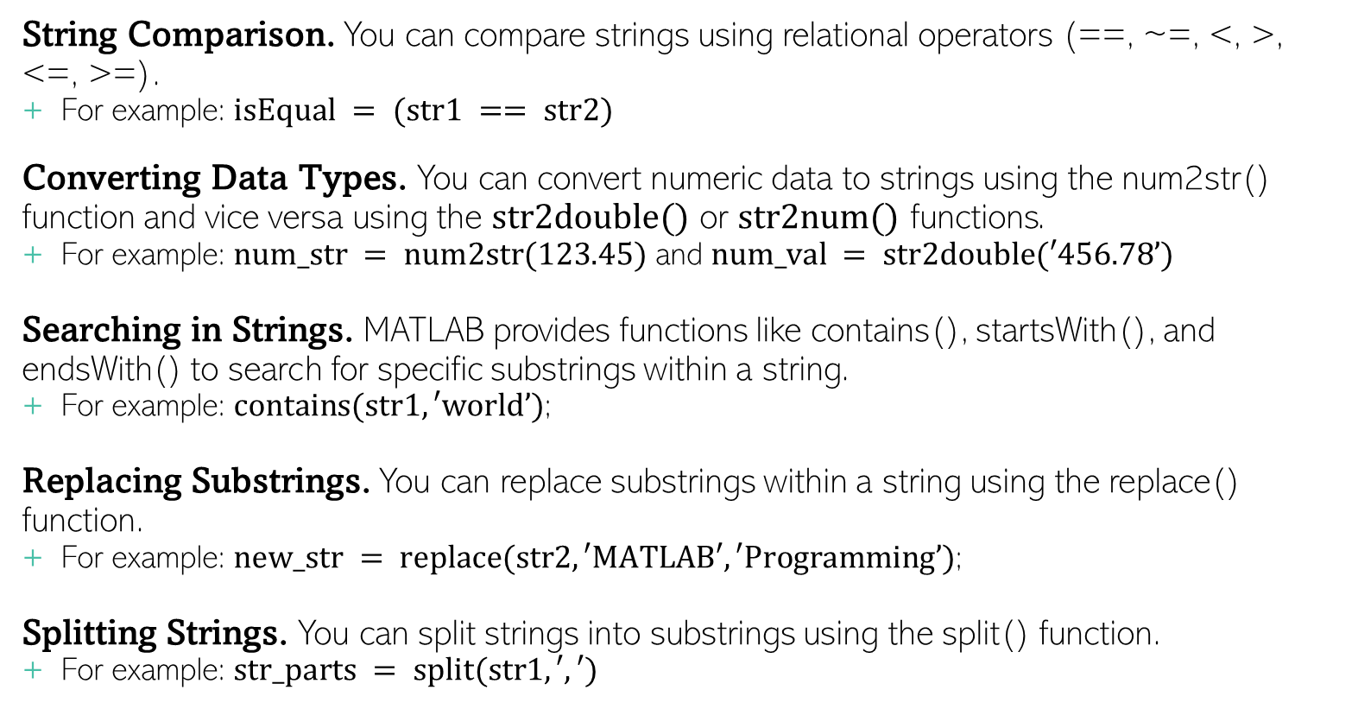
Working with Strings
String Comparison. You can compare strings using relational operators (==, ~=, <, >, <=, >=).
For example: $isEqual = (str1 == str2)$
Converting Data Types. You can convert numeric data to strings using the num2str() function and vice versa using the $str2double()$ or $str2num()$ functions.
For example: $num_str = num2str(123.45)$ and $num_val = str2double(′456.78’)$
Searching in Strings. MATLAB provides functions like contains(), startsWith(), and endsWith() to search for specific substrings within a string.
For example: $contains(str1, ′world’)$;
Replacing Substrings. You can replace substrings within a string using the replace() function.
For example: $new_str = replace(str2, ′MATLAB′, ′Programming’)$;
Splitting Strings. You can split strings into substrings using the split() function.
For example: $str_parts = split(str1, ′,′)$
MGM
Dr. Mrittunjoy
Guha Majumdar

Slide 8

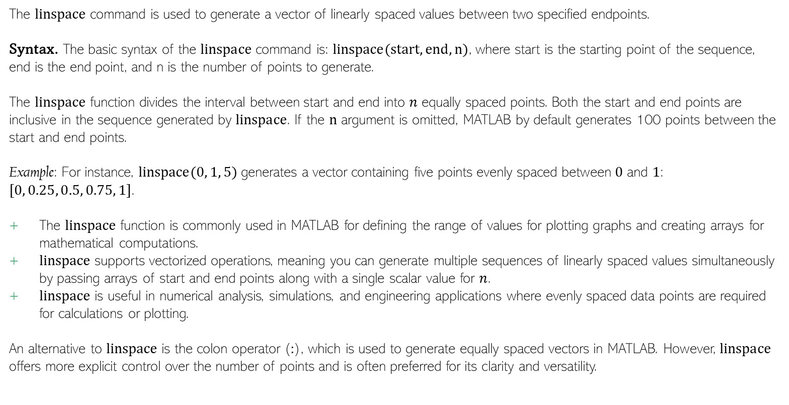
$linspace$ Command
The $linspace$ command is used to generate a vector of linearly spaced values between two specified endpoints.
Syntax. The basic syntax of the $linspace$ command is: $linspace(start, end, n)$, where start is the starting point of the sequence, end is the end point, and n is the number of points to generate.
The $linspace$ function divides the interval between start and end into $n$ equally spaced points. Both the start and end points are inclusive in the sequence generated by $linspace$. If the $n$ argument is omitted, MATLAB by default generates 100 points between the start and end points.
Example: For instance, $linspace(0, 1, 5)$ generates a vector containing five points evenly spaced between $0$ and $1$: $[0, 0.25, 0.5, 0.75, 1]$.
The $linspace$ function is commonly used in MATLAB for defining the range of values for plotting graphs and creating arrays for mathematical computations.
$linspace$ supports vectorized operations, meaning you can generate multiple sequences of linearly spaced values simultaneously by passing arrays of start and end points along with a single scalar value for $n$.
$linspace$ is useful in numerical analysis, simulations, and engineering applications where evenly spaced data points are required for calculations or plotting.
An alternative to $linspace$ is the colon operator ($:$), which is used to generate equally spaced vectors in MATLAB. However, $linspace$ offers more explicit control over the number of points and is often preferred for its clarity and versatility.
MGM
Dr. Mrittunjoy
Guha Majumdar

Slide 9
Script Files
Script files in MATLAB are plain text files that contain sequences of MATLAB commands.
They allow users to write and execute multiple commands without having to type them in the command window repeatedly.
MATLAB Path
MATLAB maintains a search path, which is a list of directories where it looks for files and scripts.
By default, MATLAB includes its own directories in the search path, but users can add their own directories to the path to access their scripts and functions easily.
Creating and Saving a Script File
To create a script file in MATLAB, you can use any text editor, such as the built-in MATLAB Editor or external editors like Notepad++ or Sublime Text.
Write your MATLAB commands in the editor, then save the file with a .m extension, which indicates it is a MATLAB script file.
Running a Script File in MATLAB
Once you have saved your script file, you can run it by typing its filename (without the .m extension) in the MATLAB command window and pressing Enter.
Alternatively, you can click on the "Run" button in the MATLAB Editor toolbar while the script file is open.
Executing Script Files
When a script file is executed, MATLAB reads and executes each line of code sequentially.
Any variables created or modified in the script file remain in the MATLAB workspace after the script finishes running.
Debugging Scripts
MATLAB provides debugging tools such as breakpoints, stepping through code, and variable inspection to help debug script files.
These tools help identify and fix errors in the script code efficiently.
Best Practices
Use clear and descriptive names for your script files to make them easily identifiable.
Comment your code appropriately to explain its purpose and any complex algorithms or logic.
Organize your script files logically and consider creating separate files for different tasks or functions to improve readability and maintainability.
MGM
Dr. Mrittunjoy
Guha Majumdar

Slide 10
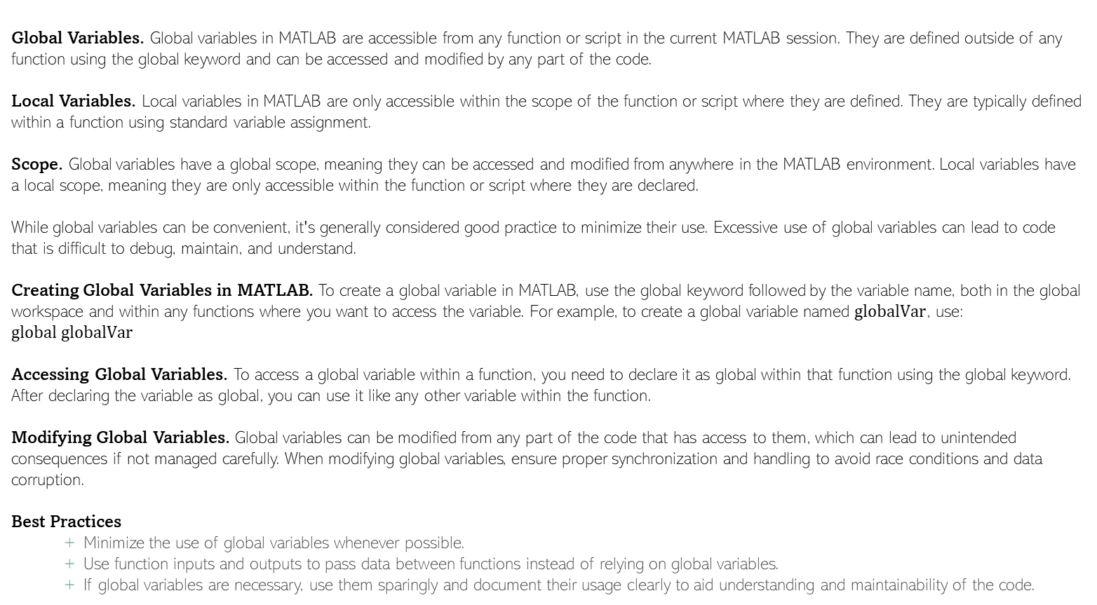
Types of Variables
Global Variables. Global variables in MATLAB are accessible from any function or script in the current MATLAB session. They are defined outside of any function using the global keyword and can be accessed and modified by any part of the code.
Local Variables. Local variables in MATLAB are only accessible within the scope of the function or script where they are defined. They are typically defined within a function using standard variable assignment.
Scope. Global variables have a global scope, meaning they can be accessed and modified from anywhere in the MATLAB environment. Local variables have a local scope, meaning they are only accessible within the function or script where they are declared.
While global variables can be convenient, it's generally considered good practice to minimize their use. Excessive use of global variables can lead to code that is difficult to debug, maintain, and understand.
Creating Global Variables in MATLAB. To create a global variable in MATLAB, use the global keyword followed by the variable name, both in the global workspace and within any functions where you want to access the variable. For example, to create a global variable named $globalVar$, use: $global globalVar$
Accessing Global Variables. To access a global variable within a function, you need to declare it as global within that function using the global keyword. After declaring the variable as global, you can use it like any other variable within the function.
Modifying Global Variables. Global variables can be modified from any part of the code that has access to them, which can lead to unintended consequences if not managed carefully. When modifying global variables, ensure proper synchronization and handling to avoid race conditions and data corruption.
Best Practices
Minimize the use of global variables whenever possible.
Use function inputs and outputs to pass data between functions instead of relying on global variables.
If global variables are necessary, use them sparingly and document their usage clearly to aid understanding and maintainability of the code.
MGM
Dr. Mrittunjoy
Guha Majumdar

Slide 11
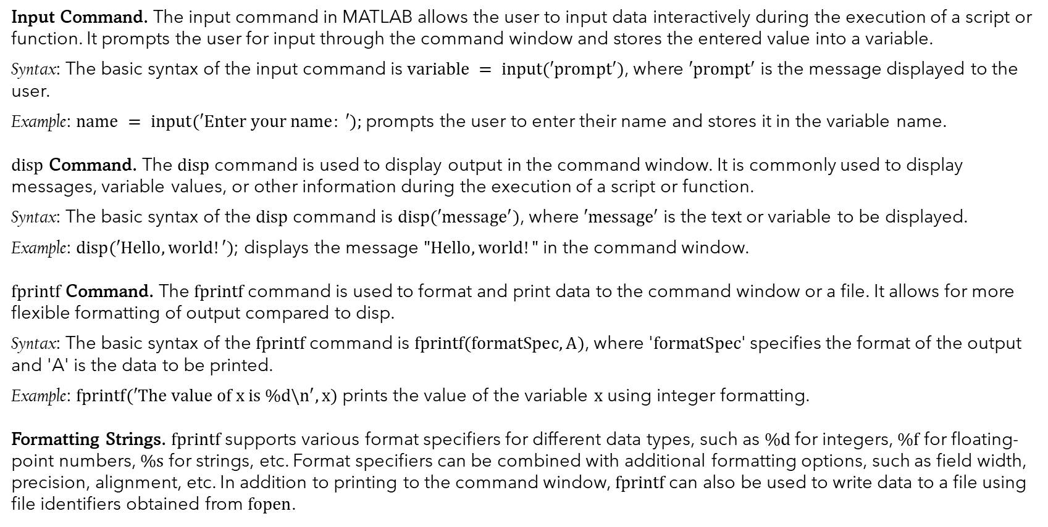
Input and Output Commands in MATLAB
Input Command. The input command in MATLAB allows the user to input data interactively during the execution of a script or function. It prompts the user for input through the command window and stores the entered value into a variable.
Syntax: The basic syntax of the input command is $variable = input(′prompt′)$, where $′prompt′$ is the message displayed to the user.
Example: $name = input(′Enter your name: ′);$prompts the user to enter their name and stores it in the variable name.
$disp$ Command. The $disp$ command is used to display output in the command window. It is commonly used to display messages, variable values, or other information during the execution of a script or function.
Syntax: The basic syntax of the $disp$ command is $disp(′message′)$, where $′message′$ is the text or variable to be displayed.
Example: $disp(′Hello, world!′)$; displays the message $"Hello, world!"$ in the command window.
$fprintf$ Command. The $fprintf$ command is used to format and print data to the command window or a file. It allows for more flexible formatting of output compared to disp.
Syntax: The basic syntax of the $fprintf$ command is $fprintf(formatSpec, A)$, where '$formatSpec$' specifies the format of the output and 'A' is the data to be printed.
Example: $fprintf(′The value of x is \%d\backslash n′, x)$ prints the value of the variable $x$ using integer formatting.
Formatting Strings. $fprintf$ supports various format specifiers for different data types, such as $\%d$ for integers, $\%f$ for floating-point numbers, $\%s$ for strings, etc. Format specifiers can be combined with additional formatting options, such as field width, precision, alignment, etc. In addition to printing to the command window, $fprintf$ can also be used to write data to a file using file identifiers obtained from $fopen$.
MGM
Dr. Mrittunjoy
Guha Majumdar

Slide 12

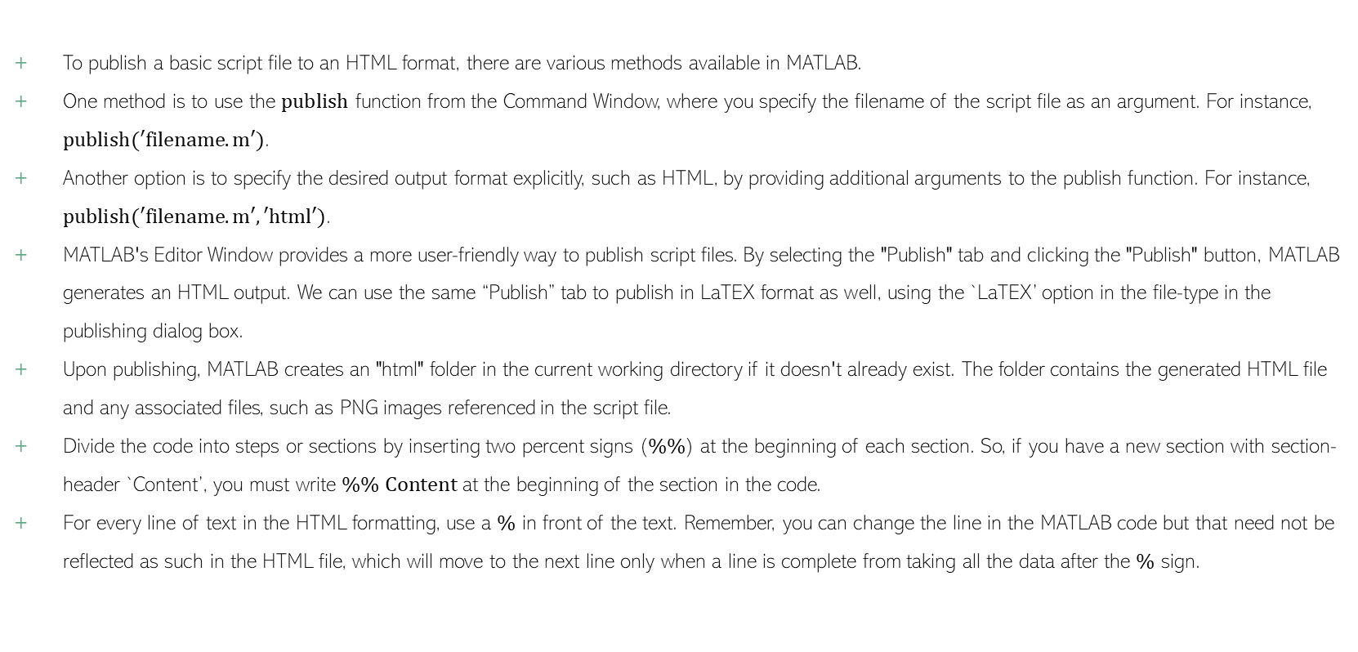
Publishing MATLAB Code in HTML
To publish a basic script file to an HTML format, there are various methods available in MATLAB.
One method is to use the $publish$ function from the Command Window, where you specify the filename of the script file as an argument. For instance, $publish(′filename.m′)$.
Another option is to specify the desired output format explicitly, such as HTML, by providing additional arguments to the publish function. For instance, $publish(′filename.m′, ′html′)$.
MATLAB's Editor Window provides a more user-friendly way to publish script files. By selecting the "Publish" tab and clicking the "Publish" button, MATLAB generates an HTML output. We can use the same “Publish” tab to publish in LaTEX format as well, using the `LaTEX’ option in the file-type in the publishing dialog box.
Upon publishing, MATLAB creates an "html" folder in the current working directory if it doesn't already exist. The folder contains the generated HTML file and any associated files, such as PNG images referenced in the script file.
Divide the code into steps or sections by inserting two percent signs ($\%\%$) at the beginning of each section. So, if you have a new section with section-header `Content’, you must write $\%\% Content$ at the beginning of the section in the code.
For every line of text in the HTML formatting, use a $\%$ in front of the text. Remember, you can change the line in the MATLAB code but that need not be reflected as such in the HTML file, which will move to the next line only when a line is complete from taking all the data after the $\%$ sign.
MGM
Dr. Mrittunjoy
Guha Majumdar
MATLAB
HTML

Slide 13
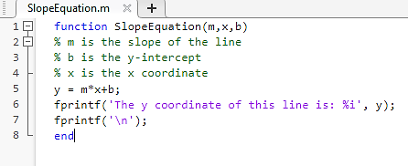
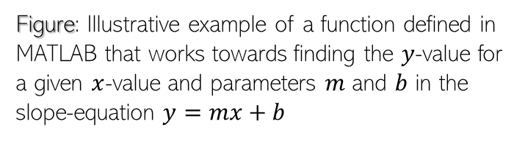

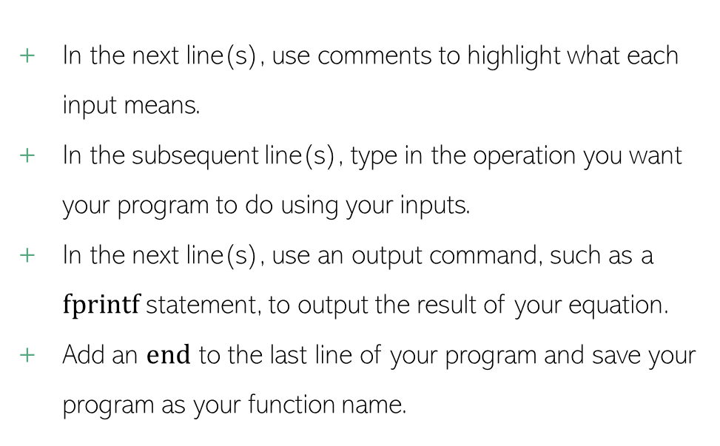
Functions in MATLAB
For defining a function, we begin the line with $function$ followed by
$$function_name(input_value1, input_value2, …,input_valueN)$$
It is important to remember that the name of your function should be the name of your file, so when you save this new script file it will be the name of your file.
In the next line(s), use comments to highlight what each input means.
In the subsequent line(s), type in the operation you want your program to do using your inputs.
In the next line(s), use an output command, such as a $fprintf$ statement, to output the result of your equation.
Add an $end$ to the last line of your program and save your program as your function name.
Figure: Illustrative example of a function defined in MATLAB that works towards finding the $y$-value for a given $x$-value and parameters $m$ and $b$ in the slope-equation $y=mx+b$
MGM
Dr. Mrittunjoy
Guha Majumdar

Slide 14
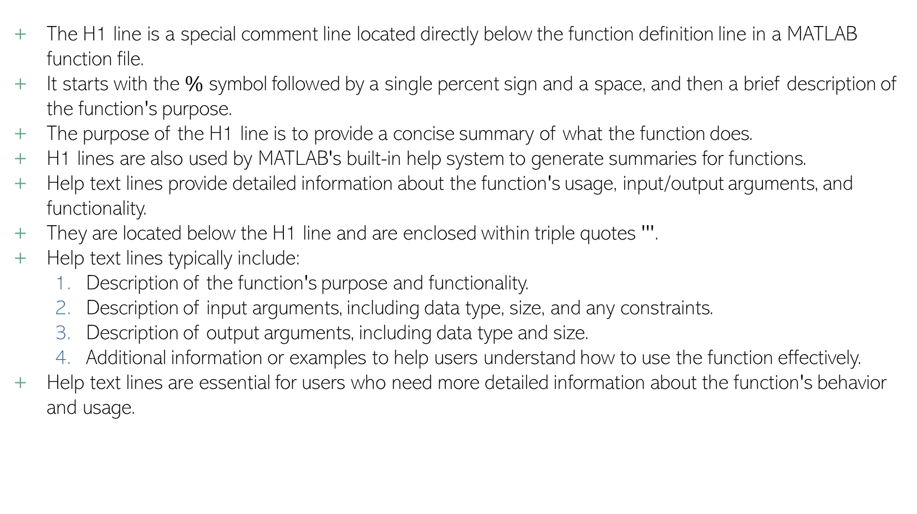
H1 and Help Text Lines in MATLAB
The H1 line is a special comment line located directly below the function definition line in a MATLAB function file.
It starts with the $\%$ symbol followed by a single percent sign and a space, and then a brief description of the function's purpose.
The purpose of the H1 line is to provide a concise summary of what the function does.
H1 lines are also used by MATLAB's built-in help system to generate summaries for functions.
Help text lines provide detailed information about the function's usage, input/output arguments, and functionality.
They are located below the H1 line and are enclosed within triple quotes '''.
Help text lines typically include:
Description of the function's purpose and functionality.
Description of input arguments, including data type, size, and any constraints.
Description of output arguments, including data type and size.
Additional information or examples to help users understand how to use the function effectively.
Help text lines are essential for users who need more detailed information about the function's behavior and usage.
MGM
Dr. Mrittunjoy
Guha Majumdar

Slide 15
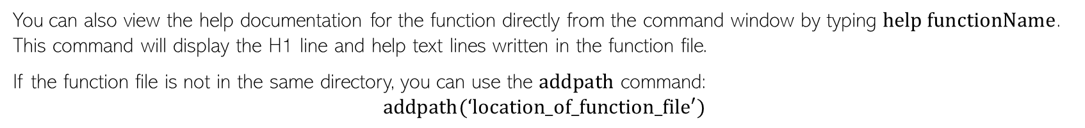
% This function computes the sum of two numbers
'''
This function computes the sum of two numbers.
Syntax:
sum = myFunction(num1, num2)
Inputs:
num1 - First number to be added
num2 - Second number to be added
Output:
sum - Sum of num1 and num2
'''
Illustrative Example
You can also view the help documentation for the function directly from the command window by typing $help functionName$. This command will display the H1 line and help text lines written in the function file.
If the function file is not in the same directory, you can use the $addpath$ command:
$$addpath(‘location_of_function_file′)$$
MGM
Dr. Mrittunjoy
Guha Majumdar

Slide 16
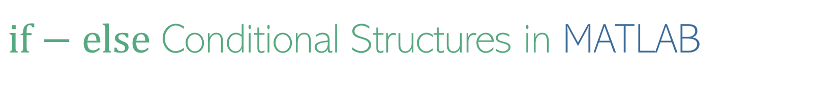
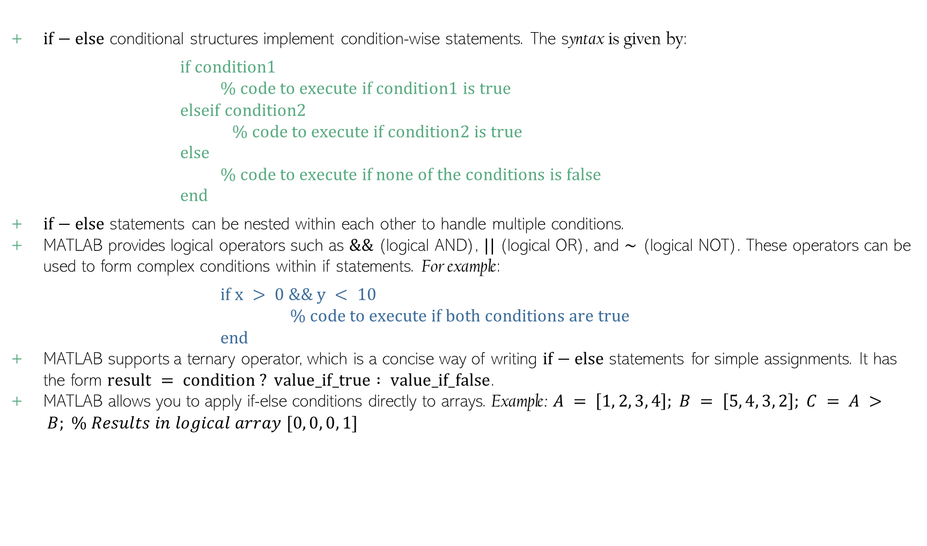
$if−else$ Conditional Structures in MATLAB
$if−else$ conditional structures implement condition-wise statements. The syntax is given by:
$$if condition1$$
$$\% code to execute if condition1 is true$$
elseif condition2
$$\% code to execute if condition2 is true$$
$else$
$$\% code to execute if none of the conditions is false$$
$$end$$
$if−else$ statements can be nested within each other to handle multiple conditions.
MATLAB provides logical operators such as $\&\&$ (logical AND), $||$ (logical OR), and $\sim$ (logical NOT). These operators can be used to form complex conditions within if statements. For example:
$$if x > 0 \&\& y < 10$$
$$\% code to execute if both conditions are true$$
$$end$$
MATLAB supports a ternary operator, which is a concise way of writing $if−else$ statements for simple assignments. It has the form $result = condition ? value_if_true : value_if_false$.
MATLAB allows you to apply if-else conditions directly to arrays. Example: $A = \left[1, 2, 3, 4\right]; B = \left[5, 4, 3, 2\right]; C = A > B; \% Results in logical array [0, 0, 0, 1]$
MGM
Dr. Mrittunjoy
Guha Majumdar

Slide 17

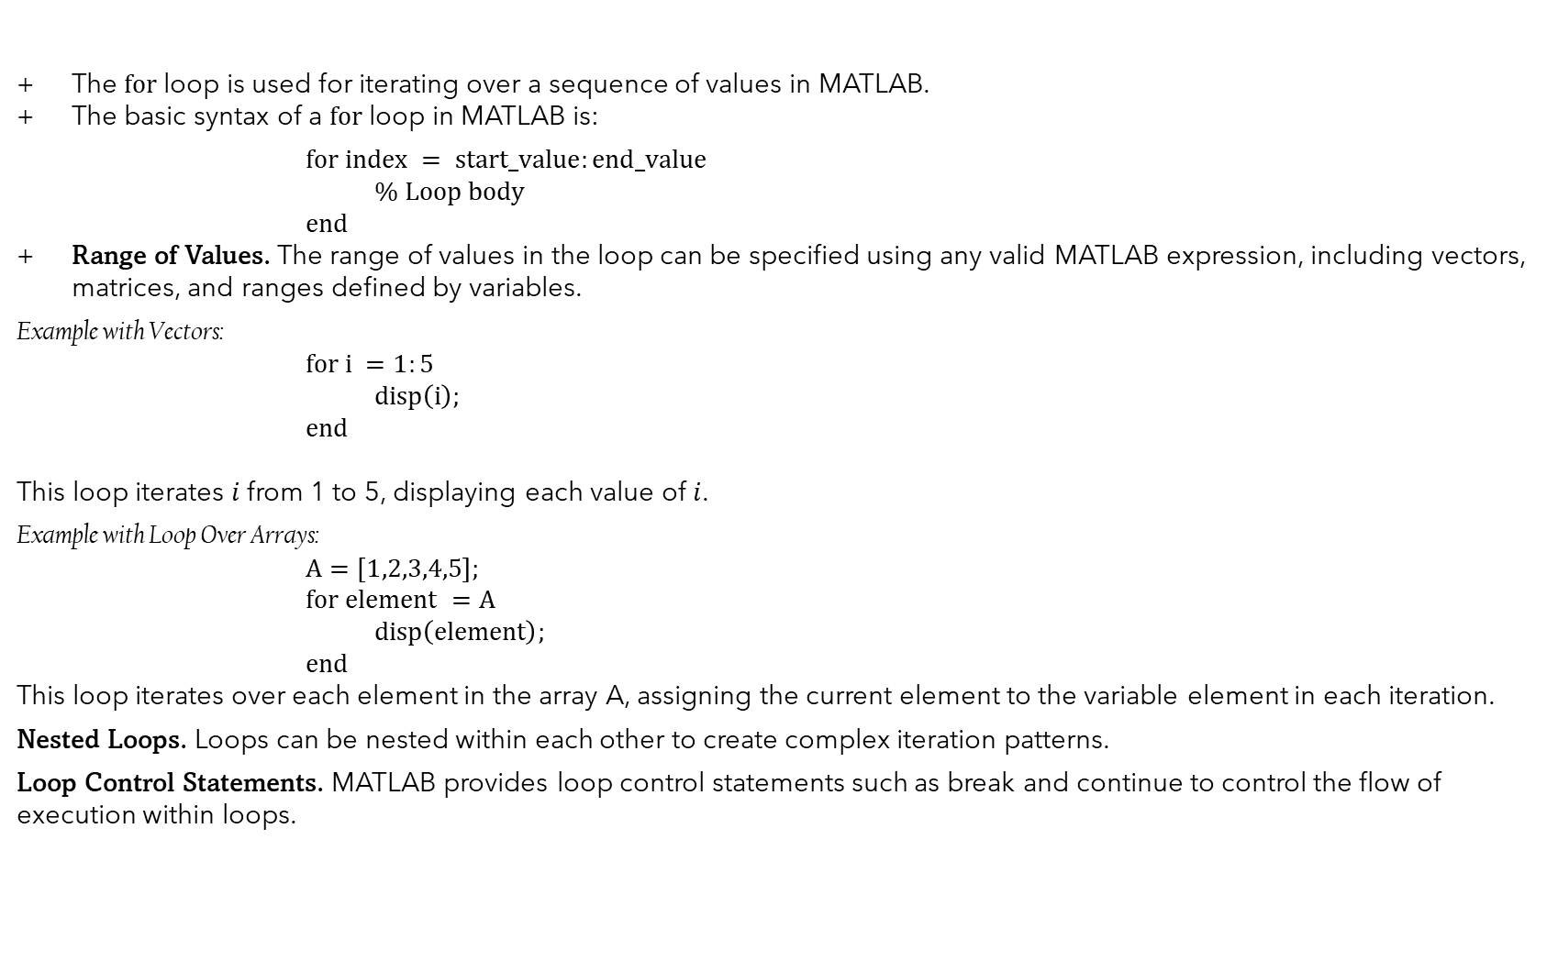
$for$ Loop in MATLAB
The $for$ loop is used for iterating over a sequence of values in MATLAB.
The basic syntax of a $for$ loop in MATLAB is:
$$for index = start_value:end_value$$
$$\% Loop body$$
$end$
Range of Values. The range of values in the loop can be specified using any valid MATLAB expression, including vectors, matrices, and ranges defined by variables.
Example with Vectors:
$$for i =1:5$$
$$disp\left(i\right);$$
$end$
This loop iterates $i$ from 1 to 5, displaying each value of $i$.
Example with Loop Over Arrays:
$$A=\left[1,2,3,4,5\right];$$
$$for element =A$$
$$disp\left(element\right);$$
$end$
This loop iterates over each element in the array A, assigning the current element to the variable element in each iteration.
Nested Loops. Loops can be nested within each other to create complex iteration patterns.
Loop Control Statements. MATLAB provides loop control statements such as break and continue to control the flow of execution within loops.
MGM
Dr. Mrittunjoy
Guha Majumdar

Slide 18
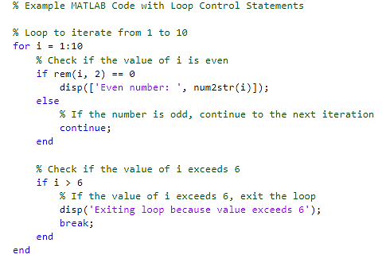
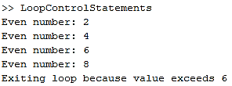
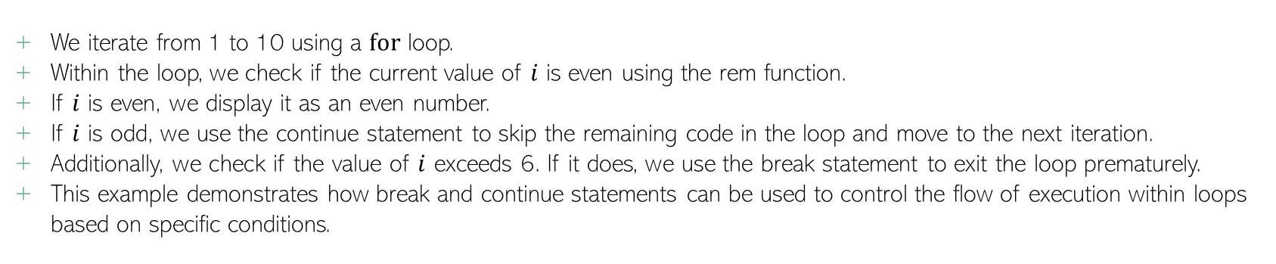
Output:
We iterate from 1 to 10 using a $for$ loop.
Within the loop, we check if the current value of $i$ is even using the rem function.
If $i$ is even, we display it as an even number.
If $i$ is odd, we use the continue statement to skip the remaining code in the loop and move to the next iteration.
Additionally, we check if the value of $i$ exceeds 6. If it does, we use the break statement to exit the loop prematurely.
This example demonstrates how break and continue statements can be used to control the flow of execution within loops based on specific conditions.
MGM
Dr. Mrittunjoy
Guha Majumdar

Slide 19
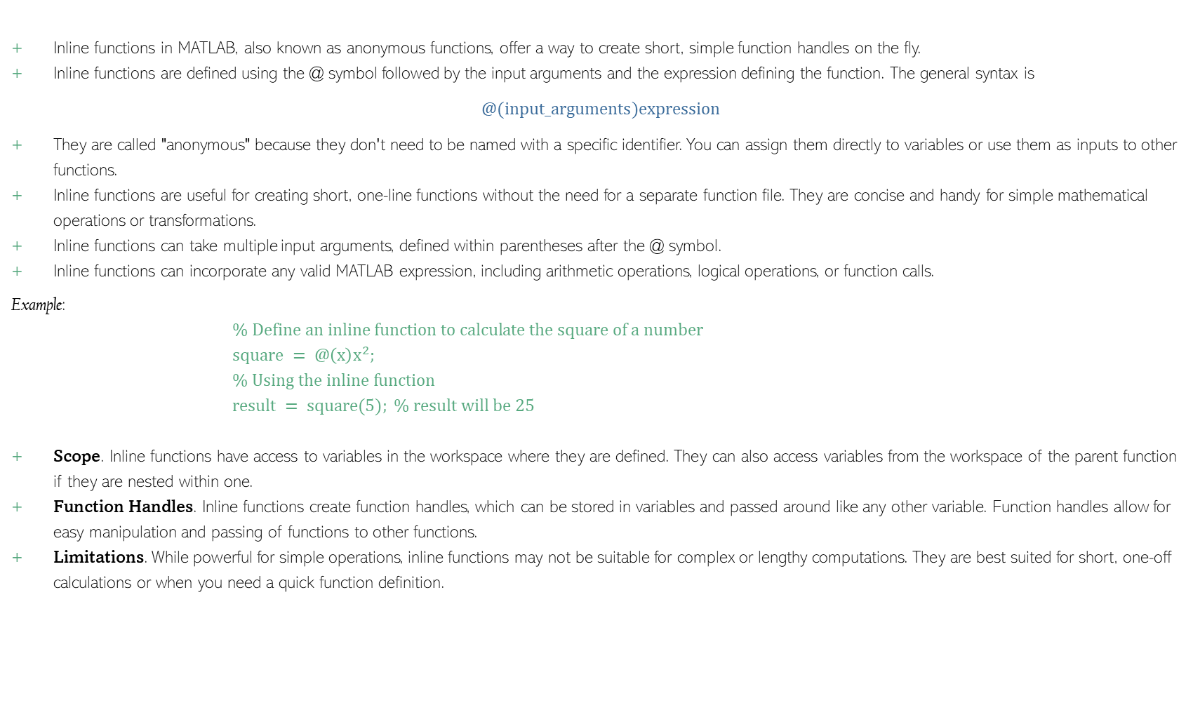
Inline Functions
Inline functions in MATLAB, also known as anonymous functions, offer a way to create short, simple function handles on the fly.
Inline functions are defined using the @ symbol followed by the input arguments and the expression defining the function. The general syntax is
$$@(input_arguments)expression$$
They are called "anonymous" because they don't need to be named with a specific identifier. You can assign them directly to variables or use them as inputs to other functions.
Inline functions are useful for creating short, one-line functions without the need for a separate function file. They are concise and handy for simple mathematical operations or transformations.
Inline functions can take multiple input arguments, defined within parentheses after the @ symbol.
Inline functions can incorporate any valid MATLAB expression, including arithmetic operations, logical operations, or function calls.
Example:
$$\% Define an inline function to calculate the square of a number$$
$$square = @\left(x\right)x^{2};$$
$$\% Using the inline function$$
$$result = square(5); \% result will be 25$$
Scope. Inline functions have access to variables in the workspace where they are defined. They can also access variables from the workspace of the parent function if they are nested within one.
Function Handles. Inline functions create function handles, which can be stored in variables and passed around like any other variable. Function handles allow for easy manipulation and passing of functions to other functions.
Limitations. While powerful for simple operations, inline functions may not be suitable for complex or lengthy computations. They are best suited for short, one-off calculations or when you need a quick function definition.
MGM
Dr. Mrittunjoy
Guha Majumdar

Slide 20
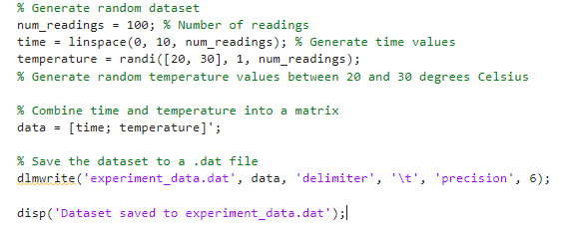
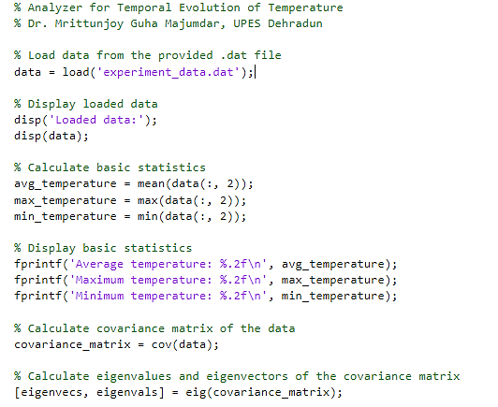
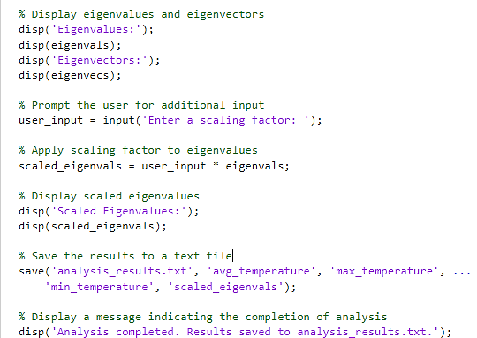
Illustrative Example using Concepts Covered
Temporal Temperature Dataset Generator
Temporal Temperature Analyzer

